Slide 1

BUSINESS ADMINISTRATION
SOFTWARE
ALA-TOO INTERNATIONAL UNIVERSITY
Spring Semester 2025-2026

Slide 2
***
The goal is to turn data into information, and information into insight.
— Carly Fiorina

Slide 3
TODAY’S STRUCTURE TWO CONNECTED PARTS
PART 1
Choosing KPIs for different roles
Setting thresholds and linked actions
Preventing “multiple truths” through KPI definition tables
Designing a small dashboard model before touching software

Slide 4
TODAY’S STRUCTURE TWO CONNECTED PARTS
PART 2
What is the 1C:Enterprise ?
How the system is structured?
How users interact with it?
How IT world should understand it professionally?

Slide 5
WHY THIS MATTERS SOFTWARE MUST SUPPORT DECISIONS
Business software does not create value simply by storing data.
Its real value appears when that data becomes usable for control, comparison, evaluation, and action.
For example:
a delivery record becomes a fulfillment KPI
a sales record becomes revenue analysis
an invoice becomes part of margin reporting
That is why KPI design and dashboard logic matter.

Slide 6
SCHOOL REPORT CARD ANALOGY
Think about a student report card. Teachers do not record every classroom action on the final report. Instead they summarize performance using selected indicators like: exam score, attendance, homework completion and final grade
A dashboard works the same way.
It does not display every transaction. It displays the indicators that help someone judge performance and decide what to do next.

Slide 7

WHAT WE ARE REALLY DOING DESIGNING CONTROL SIGNALS
A KPI is not just a number.
It is a signal that tells management whether performance is acceptable or risky.
A dashboard is not just a chart.
It is a structured view of performance designed to support decisions.

Slide 8
ROLE-BASED KPIS DIFFERENT ROLES, DIFFERENT CONTROL NEEDS
Different roles require different KPIs and supporting metrics because different roles make different decisions.
A sales manager usually cares about:
lead conversion (percentage of leads that become qualified sales opportunities or customers)
pipeline value (total estimated value of all active deals in the sales pipeline)
closed deals (number of deals successfully completed and won)

Slide 9
ROLE-BASED KPIS DIFFERENT ROLES, DIFFERENT CONTROL NEEDS
An operations manager usually cares about:
fulfillment time
stock shortages
delivery delays
A finance manager usually cares about:
margin
expenses
cash flow
Good KPI design always starts with the role.

Slide 10
HOW TO CHOOSE KPIS START WITH DECISIONS
The correct question is NOT:
“What numbers do we already have?”
The correct question is:
“What decisions does this person need to make?”
That is how KPIs should be chosen.
If a number does not support a decision, it should probably not be on the dashboard.
A dashboard must reduce noise, not increase it.

Slide 11
SALES ROLE EXAMPLE WHAT SALES NEEDS TO SEE
For a sales role, useful KPIs may include:
conversion rate
average deal value
pipeline velocity
number of qualified opportunities
These indicators help answer:
Is the sales funnel healthy?
Are deals moving fast enough?
Is future revenue becoming stronger or weaker?
This is why sales dashboards must focus on demand and movement, not only final revenue

Slide 12
OPERATIONS ROLE EXAMPLE WHAT OPERATIONS NEEDS TO SEE
For an operations role useful KPIs may include:
fulfillment time
late shipment percentage
stockout frequency
inventory turnover
These indicators help answer:
Are orders being completed on time?
Is stock being managed efficiently?
Are operational delays increasing costs or damaging service quality?
Operations dashboards must focus on flow, reliability, and speed.

Slide 13
FINANCE ROLE EXAMPLE WHAT FINANCE NEEDS TO SEE
For a finance role useful KPIs may include:
gross profit
net income
expense trend
cash collected vs invoiced
These indicators help answer:
Is the business really profitable?
Are costs growing too quickly?
Is recorded revenue becoming real cash?
Finance dashboards must focus on truth, not optimism.

Slide 14

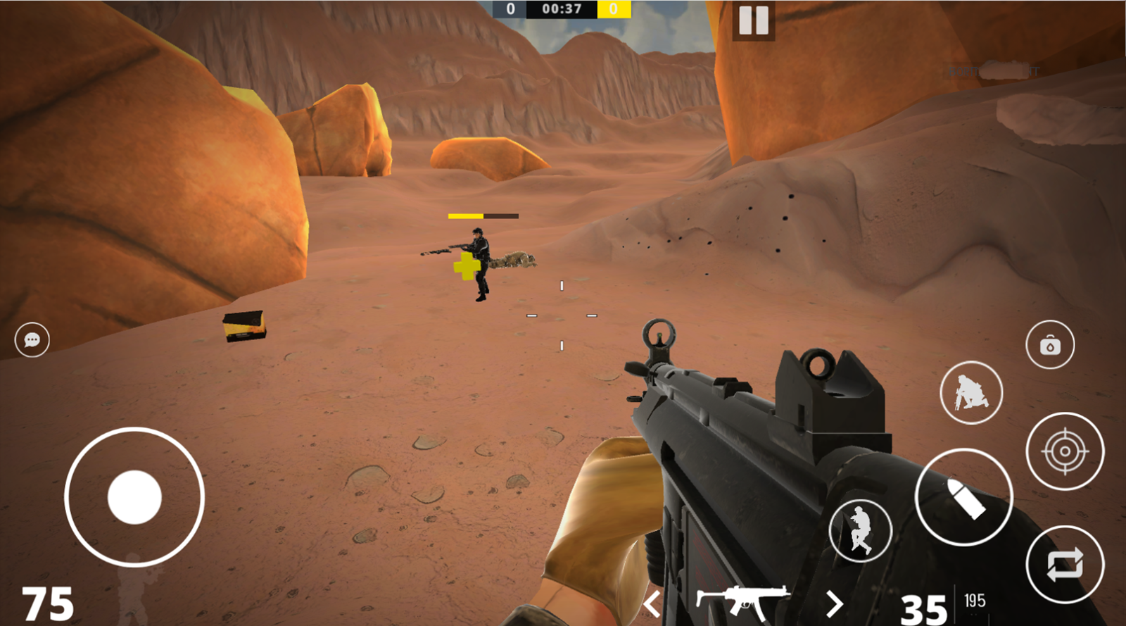
SAME SYSTEM BUT DIFFERENT VIEWS ANALOGY
In games, different players see different information:
a driver watches speed and fuel
a sniper watches distance and target position
a team leader watches map control
The system is the same, but the indicators differ by role.

Slide 15
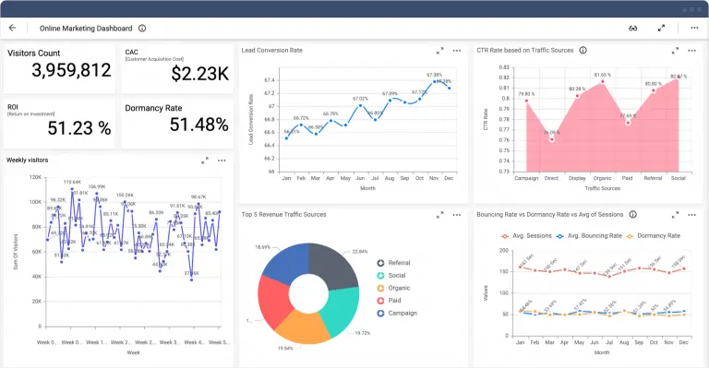
SAME SYSTEM BUT DIFFERENT VIEWS ANALOGY
Dashboards work the same way.
One business can have multiple valid views, but each view must match a clear responsibility.

Slide 16
KPI SELECTION RULE FEWER BUT STRONGER
A dashboard with too many numbers usually means that nobody made a real decision about what matters.
A good dashboard does not try to impress.
It tries to support action.
For example:
4 to 6 strong indicators are often enough for one role cuz 20 mixed indicators usually create confusion.
Better to have a small dashboard with clear meaning than a crowded dashboard with no priority.

Slide 17
FROM KPI TO ACTION WHY THRESHOLDS EXIST
A KPI becomes useful only when it has a threshold or limit.
Example:
conversion rate above 20% = healthy
10% to 20% = warning
below 10% = critical
Without thresholds, a dashboard only shows numbers.
With thresholds, it shows what the numbers mean.
That is how measurement becomes control.

Slide 18
SETTING THRESHOLDS GOOD, WARNING, CRITICAL
Thresholds usually separate performance into levels such as:
Good
Warning
Critical
This matters because managers do not only want to know the value.
They want to know whether the situation is acceptable, unstable, or dangerous.
Thresholds should be based on business reality, historical performance, or target expectations, not on random guesses.

Slide 19
SETTING ACTIONS WHAT HAPPENS AFTER THE KPI
Every important KPI should be linked to a clear action.
Examples:
low conversion → review sales qualification process
high stock aging → reduce purchasing or improve demand forecasting
rising expenses → investigate cost drivers
delayed deliveries → review logistics workflow
A KPI without action is just observation
A KPI with action becomes a management tool

Slide 20

TEMPERATURE WARNING MODEL ANALOGY
A thermometer is useful because it does more than show a number.
If temperature is normal → continue monitoring
If temperature rises too high → take action
KPIs work in the same way:
normal range → monitor
warning range → investigate
critical range → intervene
This is why thresholds and actions belong together.

Slide 21
MULTIPLE TRUTHS PROBLEM WHEN DEPARTMENTS DISAGREE
One of the most common enterprise reporting problems is this:
The sales dashboard shows one revenue number.
The finance dashboard shows another.
Why?
Because the same business word is being measured in different ways.
This creates confusion, arguments, and loss of trust in the dashboard itself.

Slide 22
WHY MULTIPLE TRUTHS HAPPEN DIFFERENT RULES, SAME WORD
Sales may define revenue as closed deals in CRM
Finance may define revenue as invoices issued or cash received
Both use the word revenue, but they are not calculating the same thing.
This is why metric definitions matter.
Without standard definitions, dashboards become inconsistent even when the software works correctly.

Slide 23
KPI DEFINITION TABLE PREVENTING CONFUSION
A KPI definition table is a simple but powerful control tool.
For each KPI, it defines:
KPI name
business purpose
formula
data source
owner
threshold
action
This is how organizations prevent “multiple truths” and maintain one version of reporting logic.

Slide 24
WHY DEFINITION TABLES MATTER ONE VERSION OF TRUTH
A definition table makes dashboards more reliable because it answers the hidden questions:
What exactly are we measuring?
How is it calculated?
Which system provides the data?
Who is responsible for it?
What happens when it fails?
Without these answers, different teams will create different numbers and call them the same KPI.

Slide 25
EXAMPLE KPI TABLE ENTRY REVENUE AS A CONTROLLED INDICATOR
KPI name | Revenue
Purpose | monitor financial performance
Formula | total invoiced amount for the reporting period
Data source | accounting / ERP
Owner | finance manager
Threshold | below target = investigate
Action | review billing, collections, or sales mix
This turns a vague business word into a controlled and traceable indicator

Slide 26
PAPER DASHBOARD MODEL BUILD THE LOGIC BEFORE SOFTWARE
Before using Power BI, Excel, or any dashboard tool, it is often better to model the dashboard on paper first.
Why?
Because software can make a bad idea look impressive.
A paper model forces clarity before design.
It answers:
What is the role?
What are the most important KPIs?
What actions should be triggered?

Slide 27
WHY PAPER FIRST WORKS THINKING BEFORE BUILDING
If people go into software too early they often focus on:
colors
chart types
layout
decoration
But paper modeling forces focus on:
logic
priorities
definitions
decision value
That is why experienced analysts often design the dashboard concept before touching any tool

Slide 28
SMALL DASHBOARD MODEL SALES EXAMPLE
A basic sales dashboard on paper might include:
Leads this week
Conversion rate
Pipeline value
Revenue vs target
One alert message
That is enough for a first version.
The goal is not to show everything. The goal is to help the sales manager decide what needs attention now.

Slide 29
SMALL DASHBOARD MODEL OPERATIONS EXAMPLE
A basic operations dashboard on paper might include:
Late shipment %
Average fulfillment time
Stockout count
Inventory aging
One action alert
This makes the dashboard role-specific, practical, and easy to test before software.
A dashboard should always feel like a work tool, not a poster.

Slide 30
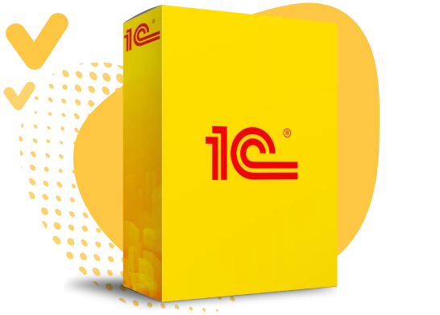
1C:ENTERPRISE INTRODUCTION WHY THIS SYSTEM MATTERS

Slide 31
1C:ENTERPRISE INTRODUCTION WHY THIS SYSTEM MATTERS
1C:Enterprise is widely used for business process and accounting automation, especially in CIS business environments.
It is not just an accounting screen. It is a platform used to build and run business applications.
1C is important because it connects:
accounting logic
operational records
ERP-style workflows
reporting and business control

Slide 32
WHAT 1C REALLY IS PLATFORM + CONFIGURATION
A useful way to understand 1C is this:
the platform is the engine
the configuration is the business application built on that engine
This means 1C is not a single fixed application.
It is an environment where business logic can be configured for accounting, trade, payroll, inventory, and other business tasks.

Slide 33
PHONE OS AND APP ANALOGY
Think about a smartphone:
Android / iOS = platform
banking app / game / messenger = application
In 1C:
1C:Enterprise platform = operating environment
accounting / trade / payroll configuration = business application
1C is more than one screen or one menu

Slide 34
DESIGNER VS ENTERPRISE MODE TWO MAIN WAYS OF WORKING
1C distinguishes two main working modes:
Designer mode
1C:Enterprise mode
Designer mode = setup, configuration, administration, development
1C:Enterprise mode = everyday business work by users inside the application

Slide 35
WHO USES WHICH MODE USERS VS IT/ADMIN
Typical everyday users work in 1C Enterprise mode:
accountants
managers
clerks or operators
Typical IT / admin / developer work happens in Designer mode:
adjusting configurations
modifying forms
maintaining system structures
administrative tasks

Slide 36
CLIENT OPTIONS HOW 1C CAN BE USED
1C supports multiple client approaches, including:
browser-based web access
installed client applications
file mode
client/server mode
This matters because companies can choose simpler or more scalable deployment depending on their size, budget, and workload.

Slide 37
FILE MODE VS CLIENT/SERVER SMALL VS LARGER DEPLOYMENT
File mode: smaller, simpler and often suitable for a single user or small setup
Client/server mode:
more scalable
better for heavier workloads
more suitable for larger organizations

Slide 38
WHAT USERS SEE IN 1C INTERFACE LOGIC
A beginner should expect the 1C user environment to revolve around:
catalogs / lists
documents
forms
reports
commands / actions
This is not a random interface.
It reflects how business data is entered, stored, processed, and reviewed inside the system.

Slide 39
CATALOGS AND DOCUMENTS MASTER DATA VS BUSINESS EVENTS
Catalogs store reference information:
customers
products
suppliers
Documents record business events:
sales
purchases
payments
shipments
This distinction is essential because most enterprise systems separate things that exist from things that happened

Slide 40
FORMS AND FIELDS HOW USERS INTERACT WITH DATA
In 1C forms are where users enter, review, and update business data.
Fields must be completed correctly, because incorrect input leads to incorrect reports and incorrect decisions.
Analogy:
A form is like an online application.
If the data entered is wrong, the final result is wrong even if the software itself works perfectly.

Slide 41
REPORTS IN 1C FROM RECORDS TO BUSINESS MEANING
1C supports reporting features such as:
report generation
calculated fields
spreadsheet-style output
charts and summaries
Data entry is not the final goal.
Reports are where business meaning becomes visible.

Slide 42
ROLES AND ACCESS WHO IS ALLOWED TO DO WHAT
1C training materials emphasize users and roles because enterprise systems must control permissions carefully.
Not every user should be able to:
create
edit
approve
delete
post documents
This is not only a technical issue.
It is also a control, accountability, and risk-management issue.

Slide 43
BASIC WORKING RULES IN 1C HOW TO WORK SAFELY
Safest working rules are:
enter data carefully
use the correct document type
do not guess unknown fields
understand before posting or saving
respect user roles and access rights
verify reports after entry
These habits matter in every enterprise system, not only in 1C.

Slide 44

FINAL TAKEAWAY FROM KPIS TO REAL SYSTEM WORK
A business needs well-designed KPIs and dashboards to avoid weak or misleading decisions
A system like 1C:Enterprise matters because it is one of the places where business records are actually created, controlled, and later turned into reports and management indicators

Slide 45
NEXT WEEK PREVIEW WHAT’S COMING
1C Enterprise workflow
Accounting entries in system form

